Slide 1




Model Writer
WP2 Semantic Parsing and Generation of Documents and Documents Components
Claire GARDENT, Mariem MAHFOUDH
CNRS / LORIA
Samuel CRUZ-LARA
University of Lorraine / LORIA

Slide 2
WP2
Goal: Provide tools and methods for:
Annotating text fragments with model elements
Converting texts to models and models to text
Tasks:
T2.1 Data Collection
T2.2 Semantic Parsing
T2.3 Natural Language Generation
T2.4 Definition of a common target semantic language
T2.5 Development of a Semantic Parser and of a Natural Language Generator

Slide 3
T.2.1 Data Collection
AIRBUS (Confidential Data)
Text
System Installation Design Principles (SIDP) Documents
986 semi-structured SIDP rules
Models
The Rule ontology represents the SIDP rules concepts. An OWL ontology composed of 30 classes, 35 object properties and 54 data properties.
The Component ontology represents the concepts and the vocabulary used in system installation rules. It is an OWL-DL ontology and it is composed in its current version of 476 classes, 21 ObjectProperties and 35 DataProperties.
Non Disclosure Agreement finalised in June 2015.

Slide 4
T2.1 Data Collection
OBEO
Text
“TxStyle" Files: a set of files in natural language (i.e., English) related to the documentation of the application being modelled by Sirius
Models
Java Concepts: a list of Java identifiers (i.e., classes, interfaces, methods, etc.) related to Sirius
Ecore Concepts: a list of concepts related to Ecore (the Eclipse Modeling Framework meta model) and to Sirius

Slide 5
T2.2 Semantic Parsing
Developed a prototype illustrating the automatic construction of an RDFS KB from text (CNRS/LORIA)
« Parsing Text into RDF » B. Batouche, C. Gardent and A. Monceaux. SEPLN 2015, Alicante, Spain.
Full scale Implementation applied to AIRBUS SIDP rules (Airbus)

Slide 6
T2.3 Natural Language Generation
D2.2.1 Report: Overview and Comparison of Existing Generators
Keynote at SEPLN 2015, Alicante, Spain
2 Internships on generation from RDF data (ongoing)
Lexicalisation: automatic acquisition of a lexicon mapping RDF properties to natural language expressions
Document planning: automatic detection of typical document structures using DBPedia and Wikipedia

Slide 7
Semantic Annotation: Creating and Maintaining Synchronization Links, Checking their Consistency

Slide 8

ModelWriter Text & Model-Synchronized Document Engineering Platform
Creating synchronization links (relating text and model) Checking the consistency of created synchronization links
Maintaining synchronization links (create, search, delete, modify)

Slide 9
Creating Synchronization Links
Automatically
Exact matching: identified using String matching
Ex: Attach (text element) IsSameAs http://airbus-group/opd-function#Attach (ontology concept)
Morphological matching: identified using lemmatization and Stanford CoreNLP tools
Ex: Attached IsMorphologicallySimilarTo http://airbus-group/opd-function#Attach
Semantic matching: identified based on ontology and SKOS labels
Ex: Fixation isSynonymTo http://airbus-group.installsys/component#AttachmentPoint
Manually
UserLink: Created by the user

Slide 10
Checking the Consistency of SynchronizationLinks
Consistency check based on ontology's axioms and properties
Rule:
If a text element and an ontology concept are semantically disjoint, then they cannot be synchronized
Ex: rigid Component cannot be synchronized with http://airbus-group.installsys/component#FlexibleComponent

Slide 11
Maintaining Synchronization Links
Link maintenance operations:
Add New Link (user given)
Search Link (create or retrieve)
Remove Link
Synchronisation between text and links
RenameTextElement
Add TextElement
RemoveTextElement

Slide 12
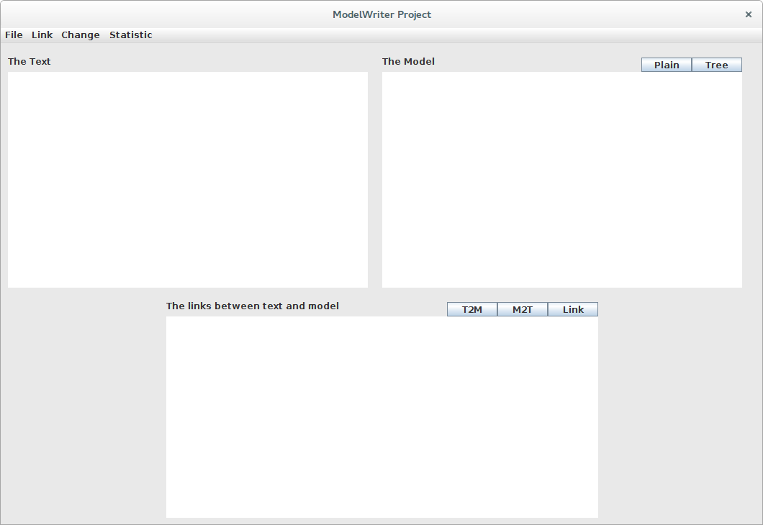
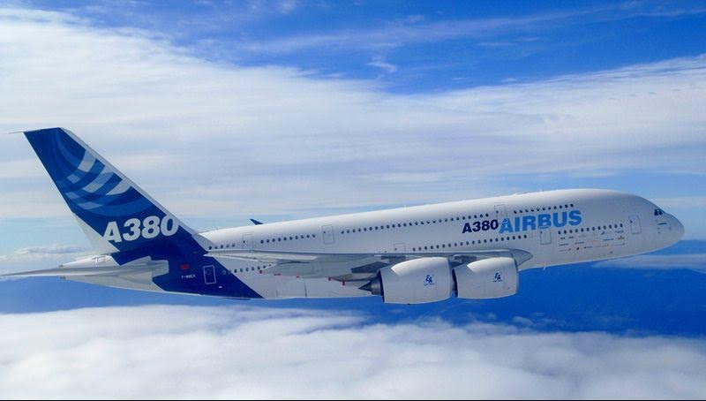
Semantic Annotation, Links Synchronization and Consistency Check
Application to Airbus Industrial Case

Slide 13
Semantic Annotation, Links Synchronization and Consistency Check
Semantic parsing and consistency check:
The prototype can be accessed on the GitHub Model Writer repository:
https://github.com/ModelWriter/WP2/tree/master/Tool

Slide 14
Semantic Annotation

Slide 15
Semantic Annotation
OBEO Corpora
EMF (Eclipse Modeling Framework)
The EMF project is a modeling framework and code generation facility for building tools and other applications based on a structured data model
From a model specification described in XMI, EMF provides tools and runtime support to produce a set of Java classes for the model, along with a set of adapter classes that enable viewing and command-based editing of the model, and a basic editor
SIRIUS
Is an Eclipse project based on EMF

Slide 16
Semantic Annotation
SIRIUS
A modeling workbench created with Sirius is composed of a set of Eclipse editors (diagrams, tables and trees) that allow the users to create, edit and visualize EMF models
The editors are defined by a model that defines the complete structure of the modeling workbench, its behavior and all the edition and navigation tools
For supporting specific need for customization, Sirius is extensible in many ways, notably by providing new kinds of representations, new query languages and by being able to call Java code to interact with Eclipse or any other system

Slide 17
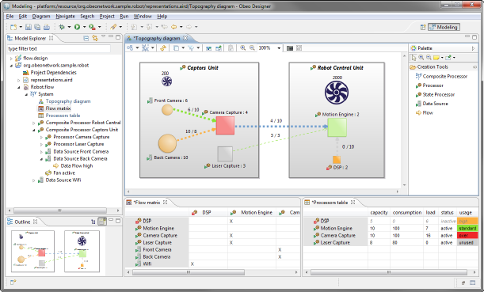
Semantic Annotation
SIRIUS

Slide 18
Semantic Annotation
OBEO Corpora
Java Concepts: a list of Java identifiers (i.e., classes, interfaces, methods, etc.) related to Sirius
Ecore Concepts: a list of concepts related to Ecore (the EMF meta model) and to Sirius
“TxStyle" Files: a set of files in natural language (i.e., English) related to the documentation of the application being modeled by Sirius

Slide 19

Semantic Annotation
A semantic annotator
We have developed is a basic prototype allowing to annotate the “TxStyle” files by establishing links to Java Concepts and to Ecore Concepts
Java Concepts
Model
Ecore Concepts
Annotated
TxStyle File
TxStyle File
Annotator
Document

Slide 20
Semantic Annotation
A semantic annotator
The prototype can be accessed on the GitHub Model Writer repository:
https://github.com/ModelWriter/WP6/tree/master/EcoreConcepts-JavaConcepts-Annotator

Slide 21
Thank you for your attention! Any question ?

